Slide 1
The Console Object
The Console object provides access to the browser's debugging console. Console Object Methods
assert()
clear()
count()
error()
group()
groupCollapsed()
groupEnd()
info()
log()
table()
time()
timeEnd()
trace()
warn()

Slide 2
Assert() & Error()
01
The console.assert() method writes a message to the console, but only if an expression evaluates to false.
Syntax: console.assert(expression, message)
The console.error() method writes an error message to the console. The console is useful for testing purposes.
works the same as console.log, except that the output is sent to stderr instead of stdout
Syntax: Console.error( message)
02

Slide 3
log(), count(), and table()
03
The console.log() It’s the most common console method, we can use console.log() to display JavaScript values in the debugger window (open the window by clicking f12 in your browser and then click on console), so we can put the console.log() in different places in our JavaScript code, and at some point we will see where the error comes from and which wrong values we get, so in this way we reduce the number of lines that we may check again to fix the error!.
cnt’d

Slide 4
log(), count(), and table()
04
The console.count() This method also helps us in debugging, it will write to the console the number of times that it was called. We can add a label that will be included in the console view, lets see a simple example on how it works:
for(let i=0;i<someArr.length;i++){ console.count(“Call number: ”); //and it will show: Call number: a number. }
This is a simple example, but if we had many lines of code in the for loop, with this method, we can check if the loop works 100% till the end, or if it stucks at some point, so we check what happens in that iteration number(the showed number from that method), and sure it will be easier to find what caused the error in that iteration.
cnt’d

Slide 5
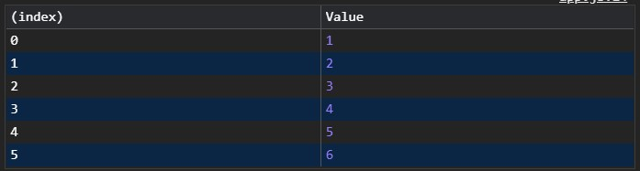
log(), count(), and table()
05
The console.table() This method shows us a table in the console view,, we should give it the first parameter which is an object or array that filled with data, and it will arrange the data inside a table, let’s see an example:
let arr=[1,2,3,4,5,6];
console.table(arr); //it will show a table with each index and its value
Here is how the table looks like:

Slide 6
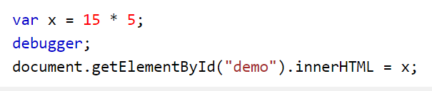
Introducing: Debugging JavaScript
Besides using console.log to track the bugs in our code, we can use debugger.
What is debugger?
Debugger is a computer program used to test programs (code).
What “debugger;” does?
It tells the google Chrome to pause the applications and stop the execution of JavaScript, and calls (if available the debugging function.
Example:
This code will stop executing before it executes the third line.

Slide 7
Why debugger and not console log?
Console log:
You have to find relevant code.
You have to add more than one console log through the code to catch and bug.
You might need to add more console log back to your code more than once.
Debugger:
More practical.
You can pause and continue.
You can use breakpoints.
You can track variables and objects.

Slide 8
Let's dive in deeper:
Setting Breakpoints:
In the debugger window you can set breakpoints in JS code.
At each point JS will stop executing, and let you examine JS values.
After examining values, you can resume execution of the code.

Slide 9
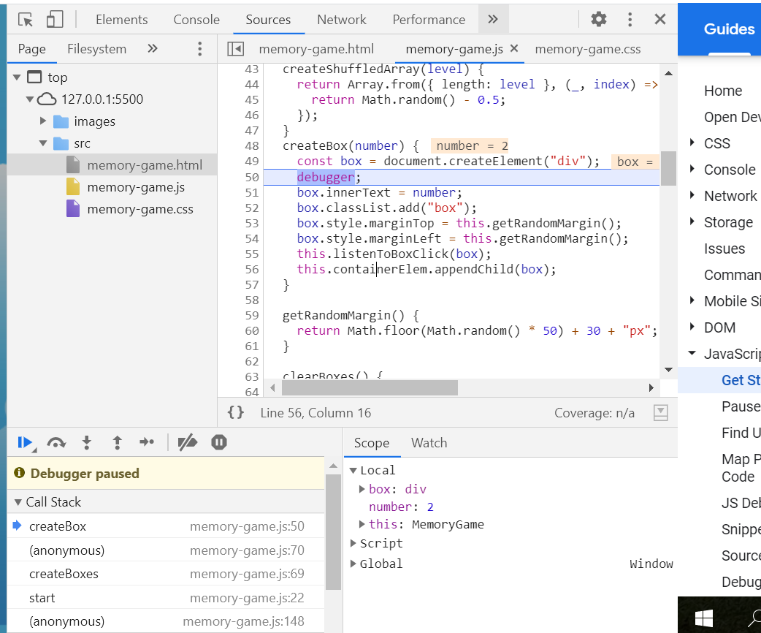
Understanding the source environment:
When we execute our program the source panel will open and we can see that it stopped on the debugger statement.
Here you debug js.
It has two main parts:
The file navigator pan.
Js debugging pan.

Slide 10
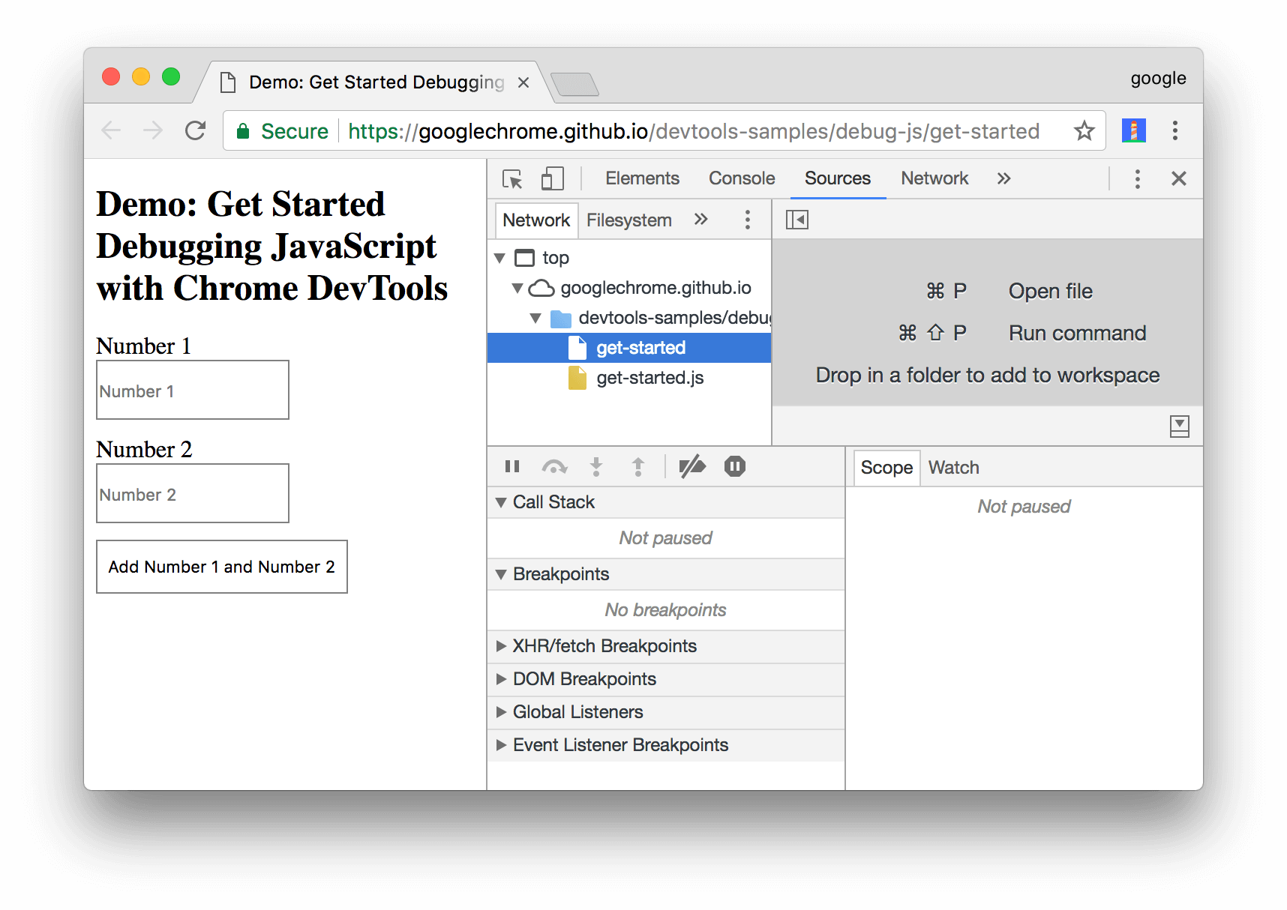
Chrome Debugger
Lets try an Example:
debug example

Slide 11


Thank you!

